Slide 1
Web Study Jam
WhatsApp Group: http://bit.ly/dscbuk-web
Repo: https://github.com/DSCBUK/web-study-jam

Slide 2
Learning Resources
https://developer.mozilla.org/en-US/docs/Learn/HTML
https://www.w3schools.com
http://udemy.com
http://egghead.io
Credentials:
Email: timothyolaleke@gmail.com
Password: LearnSomethingNew

Slide 3
HTML Structure
<!DOCTYPE html>
<html>
<head>
<meta charset="utf-8">
<title>My test page</title>
</head>
<body>
<p>This is my page</p>
</body>
</html>

Slide 4
Build a simple page with the following
A menu that links to other pages (e.g. contact.html)
Some pages on the menu should open with a new tab
Have an image within the page with a class called myimage
Include an ordered list of your Courses & unordered lists of your Hobbies
Contact Form
Create a input type of type: number, text, text area, email, url, password
Set a value for some of the input and set a disabled attribute so it cannot be changed
Comment out some part of the form
Add some Radio, Select and Checkbox
Add a Button
Write a “Hello World” program within <pre> and <code> elements.

Slide 5
Few notes about HTML
Tags are case-insensitive
The opening tag + closing tag is the element
Attributes can be used to define class, id or other properties
ICONs & Styles can be added to the <head> using:
<link rel="shortcut icon" href="favicon.ico">
<link rel="stylesheet" href="my-css-file.css">
Meta description that has the potential to make your page appear higher in relevant searches performed in search engines (SEO)
<meta name="author" content="Chris Mills">
<meta name="description" content="The MDN Web Docs Learning Area aims to provide complete beginners to the Web with all they need to know to get started with developing web sites and applications.">

Slide 6
Deploy our Website on GitHub Pages
Open a GitHub Repo
Push your codes
Enable GitHub Pages in Settings

Slide 7
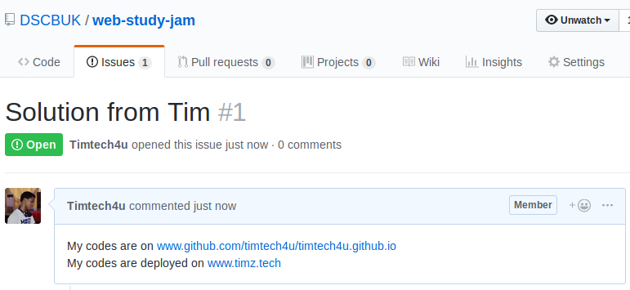
Completion Tasks
Learn about HTML Tables update your HTML codes with a nice table
Push the changes to GitHub
Deploy on GitHub Pages
Submit by creating a new issue on:
https://github.com/DSCBUK/web-study-jam/issues

